Slide 1
Module 3 Work – Mar 25
Agenda
Software Accessibility Presentations
Alisha, Gursimrat, Khushi (Today& Tomorrow))
Module A.3: Dream Machine
Level 3 & 4 Now Available
Module B.3: Intermediate Python Programming
Level 3 & 4 … TBD
Show Me Your Tic-Tac-Toe Game
Upcoming
Tomorrow : Continue Module 3 Work

Slide 2


Dream Machine A.3
Level 3: Building Your Machine
Identify / Prioritize Options
Establish a Budget
Order On-Line

Slide 3
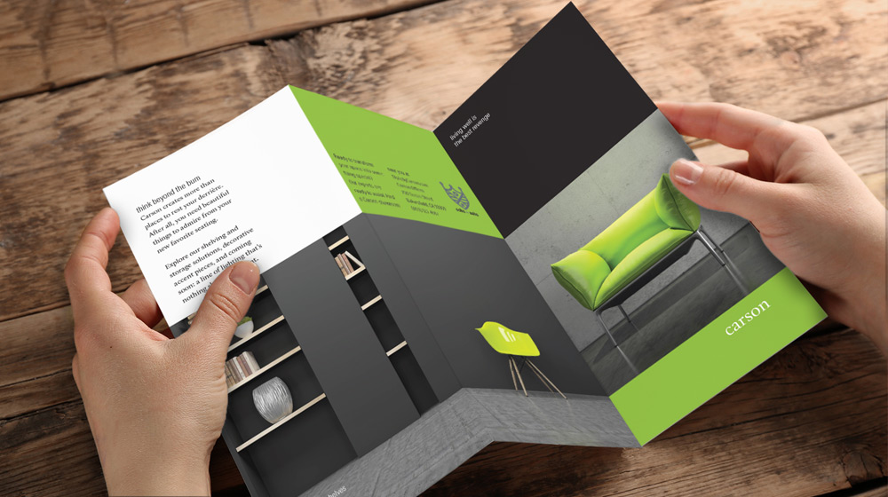
Dream Machine A.3
Level 4: Sharing Your Machine
Create a Brochure
Present at Trade Show

Slide 4
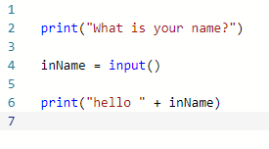
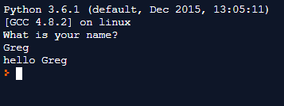
Python Input

